Slide 1

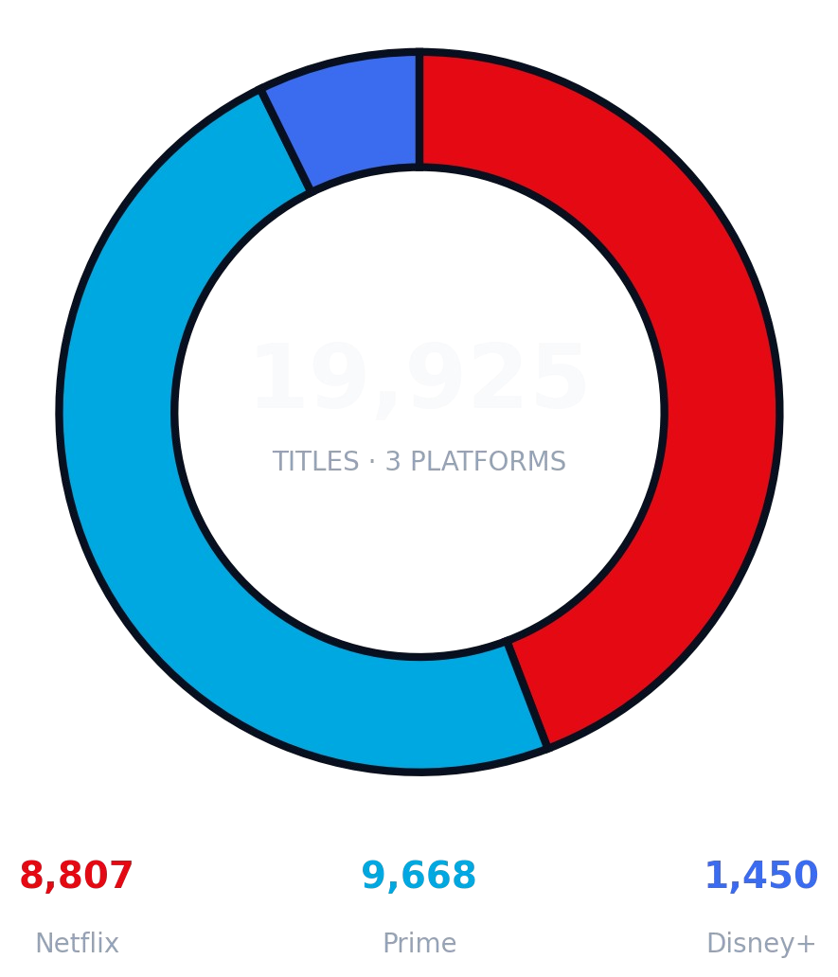





Movie & OTT Platform Content Analysis
A Multi-Platform Catalogue Study | Binge-Metrics
An inventory study of 19,925 titles across Netflix, Amazon Prime and Disney+: library strategy, production trends and cross-platform exclusivity.
Developed By : Satvik Parihar
Enrollment No. : 23002170510039
Branch : AIDS
Python 3.13
Pandas
Pytest
Power BI
Star Schema DAX

Slide 2






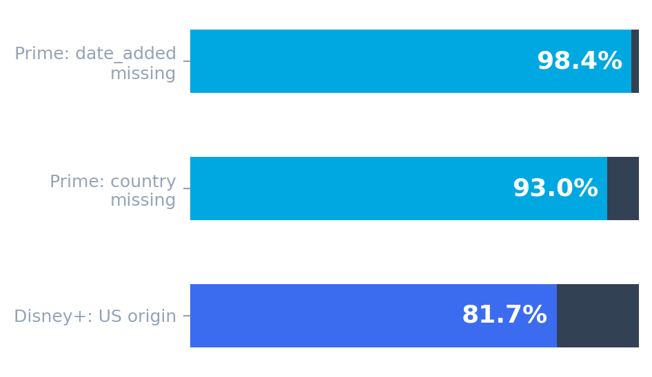




Data Audit
3 Kaggle snapshots · 19,925 rows · 0 duplicate IDs · 4 anomalies found before analysis
/ / 0 2 D A T A A U D I T
Missingness & provenance
Netflix shifted rows
Prime missingness
3 titles had movie duration typed in the rating box. Repaired with Python, no rows deleted
98% of added dates and 93% of countries were missing. Kept as "Unknown" without guessing
Disney+ provenance
85 very short movies
82% of content is from the US. It is the global Disney+ library, not Indian Hotstar
85 movies were under 5 minutes (trailers/intros). Flagged so they don't skew the average
Audit first, transform second, never fabricate.

Slide 3


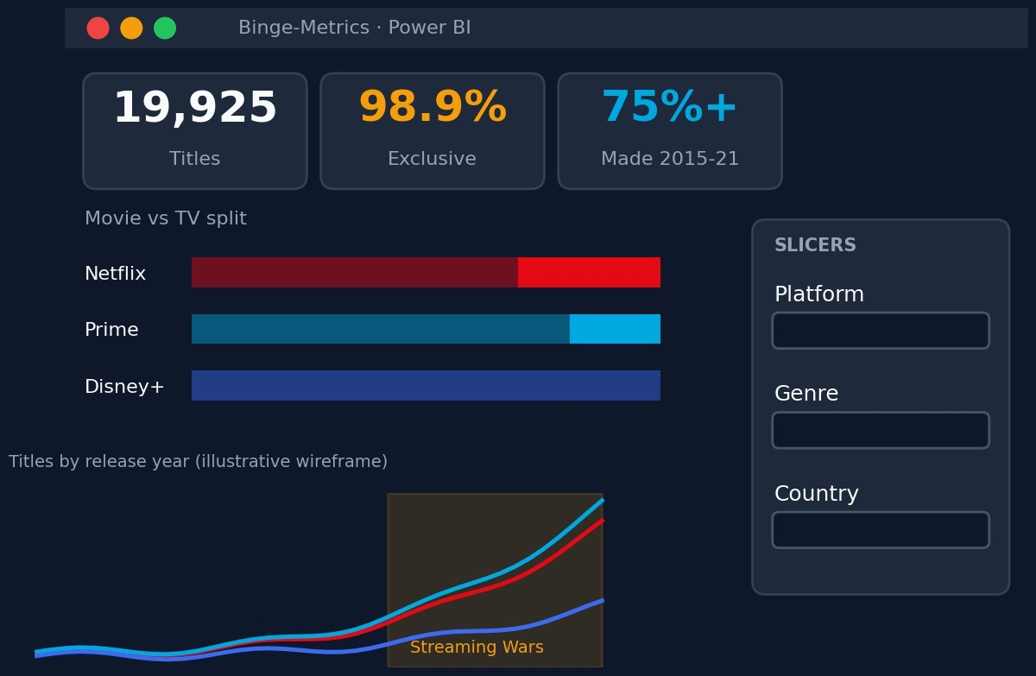
The Power BI dashboard
Catalogue composition and median movie runtime
/ / 0 4 A N A L Y T I C S
Movie vs TV share (%)
80.8
19.2
Prime
69.6
30.4
Netflix
Movies
TV Shows
Median movie runtime
98
94
83
Netflix
Prime
Disney+

Slide 4





Streaming Wars & the exclusivity wall
Production boom and cross-platform overlap
/ / 0 5 I N S I G H T S
Prime = movie library
80.8% Movies, the highest movie share
75%+
MADE 2015–2021
98.9%
EXCLUSIVE
Netflix = retention
Highest TV share at 30.4%
Over three-quarters of all content on the 3 services was produced at the Streaming Wars peak.
19,485 of 19,705 unique titles live on one platform. Only 220 are shared.
Disney+ = family
Shortest median runtime: 83 min

Slide 5





Tools Used
/ / 0 6 M E T H O D O L O G Y
Python Data Engineering
This is an inventory study of content. Catalogue size does not mean higher viewership, popularity, or revenue
Python Data Engineering
Python Data Engineering
This is an inventory study of content. Catalogue size does not mean higher viewership, popularity, or revenue
Python Data Engineering
Pytest (Unit Testing)
Power BI Desktop & DAX
Pandas: Ingested 19,925 raw rows, repaired shifted values, and built Star Schema tables.
Matplotlib: Generated independent benchmark metrics and validation charts.
Pandas: Ingested 19,925 raw rows, repaired shifted values, and built Star Schema tables.
Matplotlib: Generated independent benchmark metrics and validation charts.
Verified 100% row preservation, duration/seasons split, and overlap logic
Linked fact tables, platform dimensions, and bridge tables.
DAX Measures: Built dynamic measures to prevent double-counting.

Slide 6
THANK YOU
Movie & OTT Platform Content Analysis (Binge-Metrics)

